Slide 1
L1d1
Cu boulder
Csci 3155: principles of programming languages
Summer 2018
Spencer wilson
June 4, 2018

Slide 2
PLAN
Brief overview of the course
A bit about me
Intro to functional programming
In class exercise
Scala Playground (See L1D1_playground.scala posted on Moodle)

Slide 3
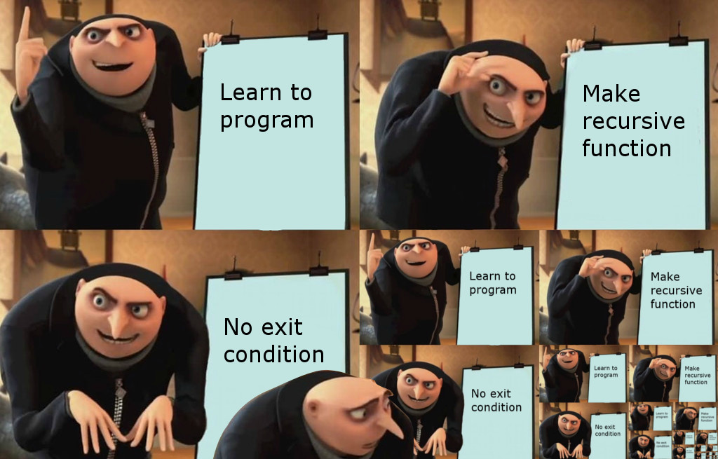

Slide 4
Warm up (in class exercise part 1)
In you favorite programming language, write a script to print the numbers 1 through 100. The program should print 1 then print 2 then 3 and so on until it prints 100. It should not print anything else

Slide 5
ANNOUNCEMENTS
Anyone still on the waitlist? Come see me after class
Lab 1 is live. It’s due Friday 6/8 (but sort of Saturday 6/9)
Time conflicts
set a meeting with me via Piazza in a private message direct to “Instructors” – ASAP
Today 06/04 Office Hours will be in ECCS 102 from 6:30 – 7:30
Moving forward office hours will be from 4:00 – 5:00 in ECCS 102

Slide 6
ANNOUNCEMENTS Cont
First Moodle assignment was due before class today
This is the one time that I will move the due date. It is now extended to tomorrow before class. You should do this in addition to tomorrows regular Moodle assignment
Tomorrow there is another Moodle assignment that is due before class

Slide 7
ANNOUNCEMENTS : accommodations
A variety of students have accommodations for exams and notes
Please contact me ASAP to help me make sure that you have everything that you need to success
Test accommodations
Message on Piazza today direct to “Instructors”
Get the forms to me by Thursday 06/08 evening in Office Hours
Note accommodations: I am seeking a notetaker for the course… still looking into logistics but I would love for someone with great notetaking skills to volunteer their notes to other students.

Slide 8
CSCI 3155

Slide 9
CSCI 3155: languages (1 of 2)
Consider the warm up exercise (part 1 of today’s in-class exercise)
What languages did you all use? (Spencer… write those into this slide)

Slide 10
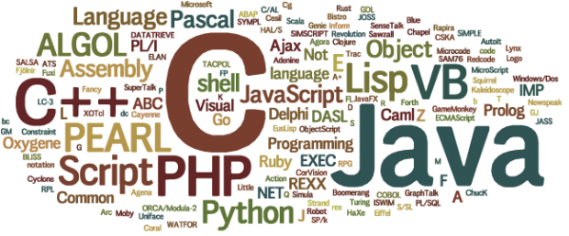
CSCI 3155: languages (2 of 2)

Slide 11
CSCi 3155: what we’ll cover
Programming in Scala
Programming in the functional paradigm
Tools to formally describe a programming language and its behavior
What is an interpreter, what is it good for?
What is parser, what is it good for?
What is a program really? (We’ll look at one way to view programs, the functional way)

Slide 12
CSCi 3155: what we’ll sort of cover
Common language features, what they’re good for and when you might want to use them
How to extend a programming language to have new features
Why the functional programming model is increasing in popularity
How to pick up new languages quickly

Slide 13
CSCi 3155: what we won’t cover
What languages have desired features
Proving that the language is correctly defined
The syntax of lots and lots of languages

Slide 14
CSCi 3155: Labs
Lab 1: intro to scala, AST, and Grammars (1 week)
Lab 2: intro to nodejs, interpreters, and inference rules (1 week) – HARD WEEK
Lab 3: using inference rules to build interpreters, scoping (1.5 weeks)
(midterm)
Lab 4: Higher order functions, type systems (2 weeks) – DIFFICULT LAB
Lab 5: monads (2 weeks) – Perhaps the HARDEST LAB
Lab 6: parsing, advanced grammars (1+ week)
(final exam)

Slide 15
CSCi 3155: Typical workflow
Before class you have
An advised section of the lab to complete or attempt
A brief reading assignment
A moodle assignment covering the reading and lab portions
In class
Q&A on the before class assignments
Advanced discussions on topics in before class assignments
Examples and practice with the material
First exposure to the next days readings
Q&A on the lab

Slide 16
Tools
Moodle
Piazza
Google Calendars
? VMWare, IntelliJ, Scala, Node
GitHub Classroom (not ready yet)
INGinious (not ready yet – likely won’t be ready until lab 2)

Slide 17
Textbooks
A brief mention

Slide 18
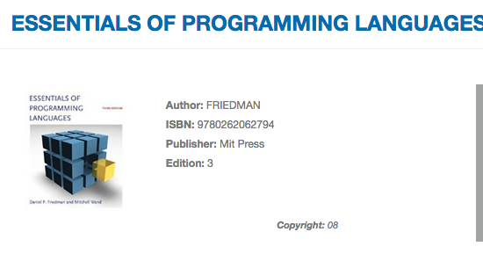
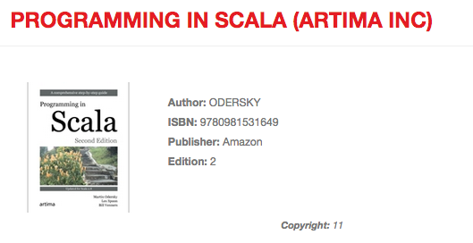
Course textbooks

Slide 19
Course readings
The Gist of PL: I wrote these special for the summer course. They’re specialized notes on the course content and lab material
csci3155_notes: Written by another professor, Dr. Evan Chang, provides textbook level detail on course content and lab materials but ends partway through lab 4.
Youtube: I rarely find great videos but when I do I’ll share them… I might start making a few videos as time permit.

Slide 20
Questions?
?
CSCI 3155: a brief overview

Slide 21
Spencer

Slide 22
Brief background
From Indiana (near Indianapolis)
Boarded high school in Tennessee
B.S. of Computer Science, Minor Business Administration from CU Boulder
10th semester in an education position at CU (PLA, CA, Grader, TA, Instructor)
6th time working with this course material
2nd time as instructor of this course and in general
Full time software engineer at Northrup Grumman in Aroura, Colorado

Slide 23
Programming languages
Use (Descending order)
Studied but never use
JavaScript
Python
Bash
Scala
Matlab
C
C++
…
Lisp/Scheme/LispCommon(LC)
Haskell
Verilog
GoLang
Ruby
FiM++ (friendship is magic)
…

Slide 24
Intro to functional programming

Slide 25
Intro to functional programming
Consider the warm up exercise (part 1 of today’s in-class exercise)
How many of us used a loop?
While?
For?
Until?

Slide 26
In class exercise

Slide 27
ICE L1D1
Consider the warm up exercise (part 1 of today’s in-class exercise - ICE)
Is there a way to write the program without loops?
Flip the page over and try it

Slide 28
Stuck?
Can we write the program without loops or mutable variables?
Thoughts?

Slide 29
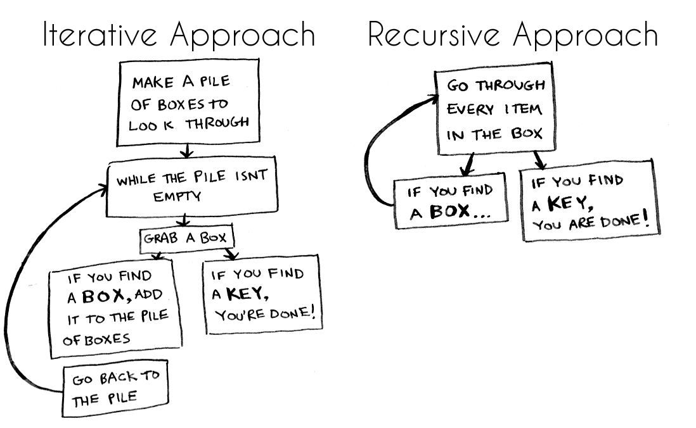

Slide 30
Functional Programming In this course
Only liars use mutability
Types are AWESOME, get over it…
Functions are values (I’ll prove this to you in due time)

Slide 31
Make teams of 2
Every lab will be done in teams of 2 (3 if needed)
I will encourage you to make new teams every lab, meet new people and learn how to work with them

Slide 32
Scala playground
See L1D1_scalaPlayground.scala posted on Moodle

Slide 33
Github
Throughout the semester we will be using github classroom to host private repositories.
There was a snag setting up the github classroom and it’s not available for Lab1
Please disregard that portion of the lab writeup.
If you must work on a public repo for lab 1 I will ask that at the end of the lab you remove that repository. I will provide a private repo ASAP for you to host that work on for your future reference.

Slide 34
# ToDo
Monday Moodle assignment (usually due before class)
Introduce yourself on Piazza in the “introductions” folder
Set up the programming environment (VM optional)
Print the Lab 1 document and start notating it as you see necessary
Do the Tuesday Moodle Assignment
Complete Lab 1 Questions 2, 4, and 5
Attempt Lab 1 Question 6.c

Slide 35
